Slide 1
Exploring The Link Between Education and Career Success Alexander Boyd IS219 Spring 2025 Data Story Application Project

Slide 2
Essential Question: How do the choices made in one's academic journey impact their career outcomes? Background:
In the age of information, the professional landscape has seen much change in the way skills and knowledge are passed on.
In many fields, especially those centered around technology, education is no longer the only ticket into the professional world.
There are many who believe academia to be optional for entry. In my project, I seek to take an objective look at the data and come to a conclusion on whether or not school is the be-all, end-all for career success.

Slide 3

IDE Setup

Slide 4
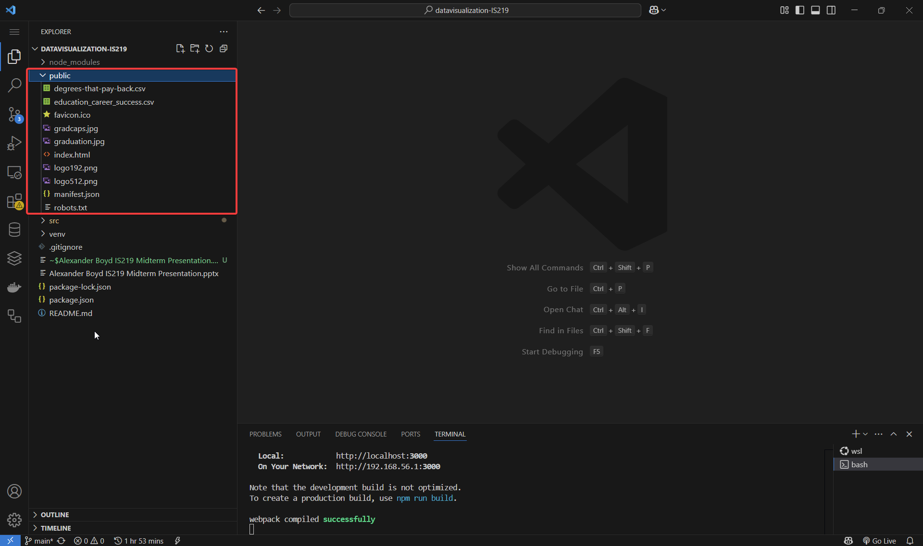
Public
My main folder (as shown on the right) is the directory where all my publicly accessible elements are kept.
These are elements that can be accessed by the web browser when the application is run. This of course, includes our dataset.

Slide 5
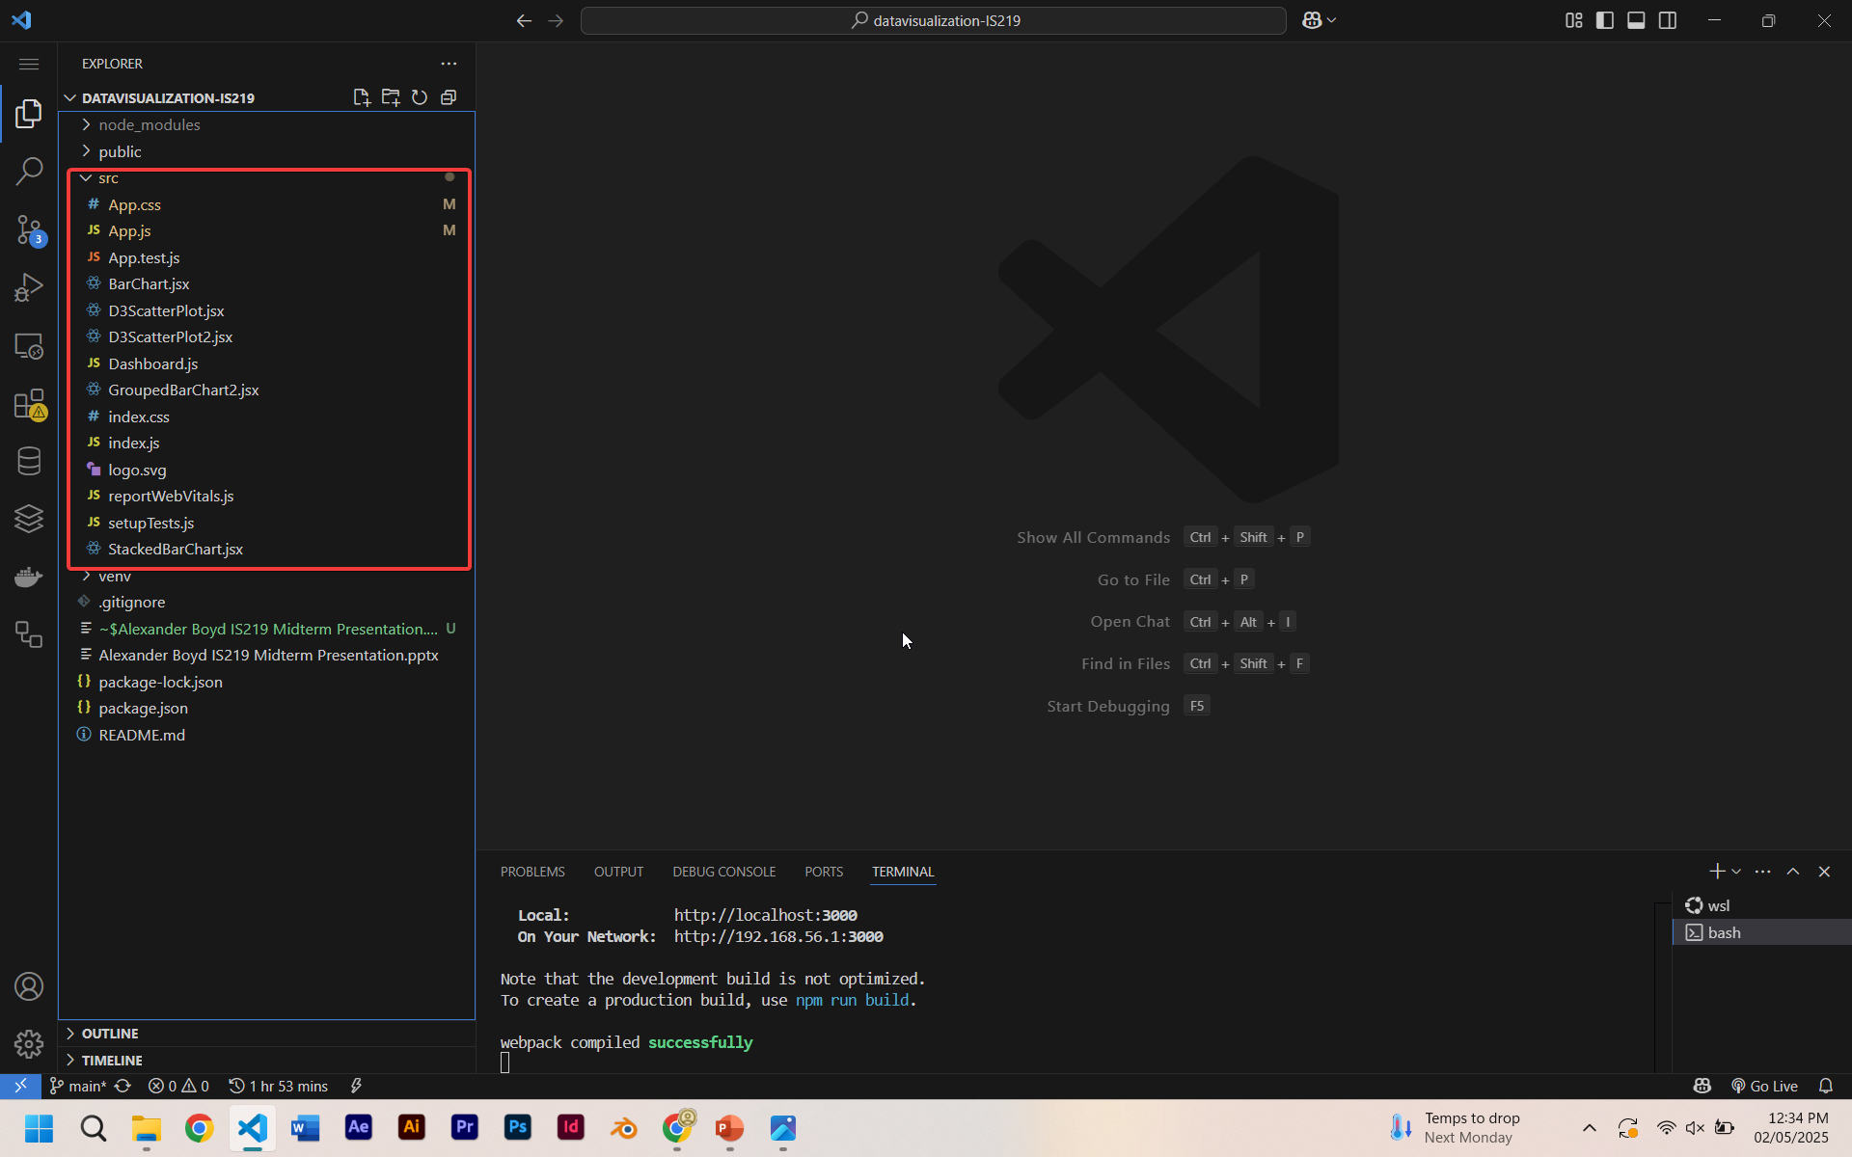
src
My src folder (as shown on the right) is the directory that contains all of my code and my react elements.
This is where I’ve stored all the files that generate the application. These are executed in the background and produce a webpage we can interact with.

Slide 6

The Application

Slide 7
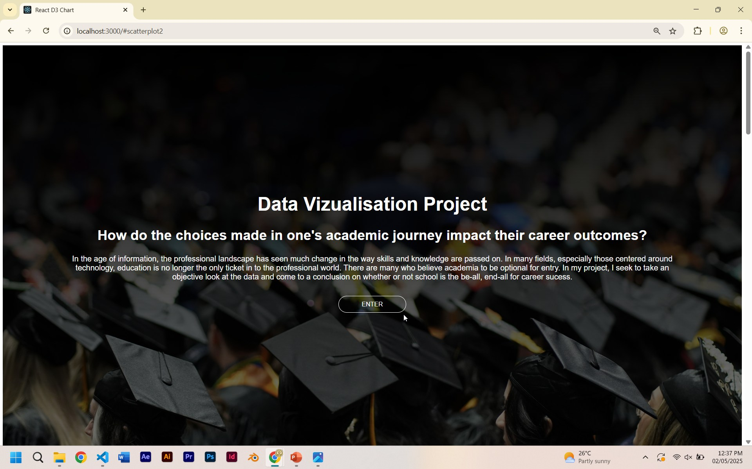
Homepage
I created this using html and CSS. This is a landing page that introduces the project and the essential question, giving a brief description.
There is a call to action which links to the rest of the page.

Slide 8
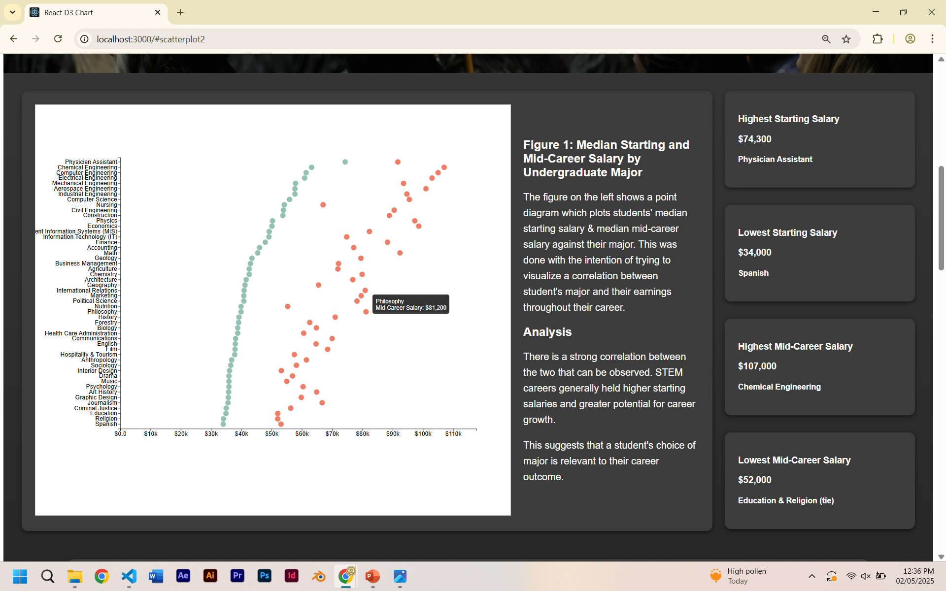
Figure 1
I created this using D3’s visualization library. This was created using Dataset 1.
The figure shows a correlation graph which compares the starting salary with the mid career salary of graduates, by major.
This was done with the intention of trying to visualize a correlation between field of study and earnings across one’s career.

Slide 9
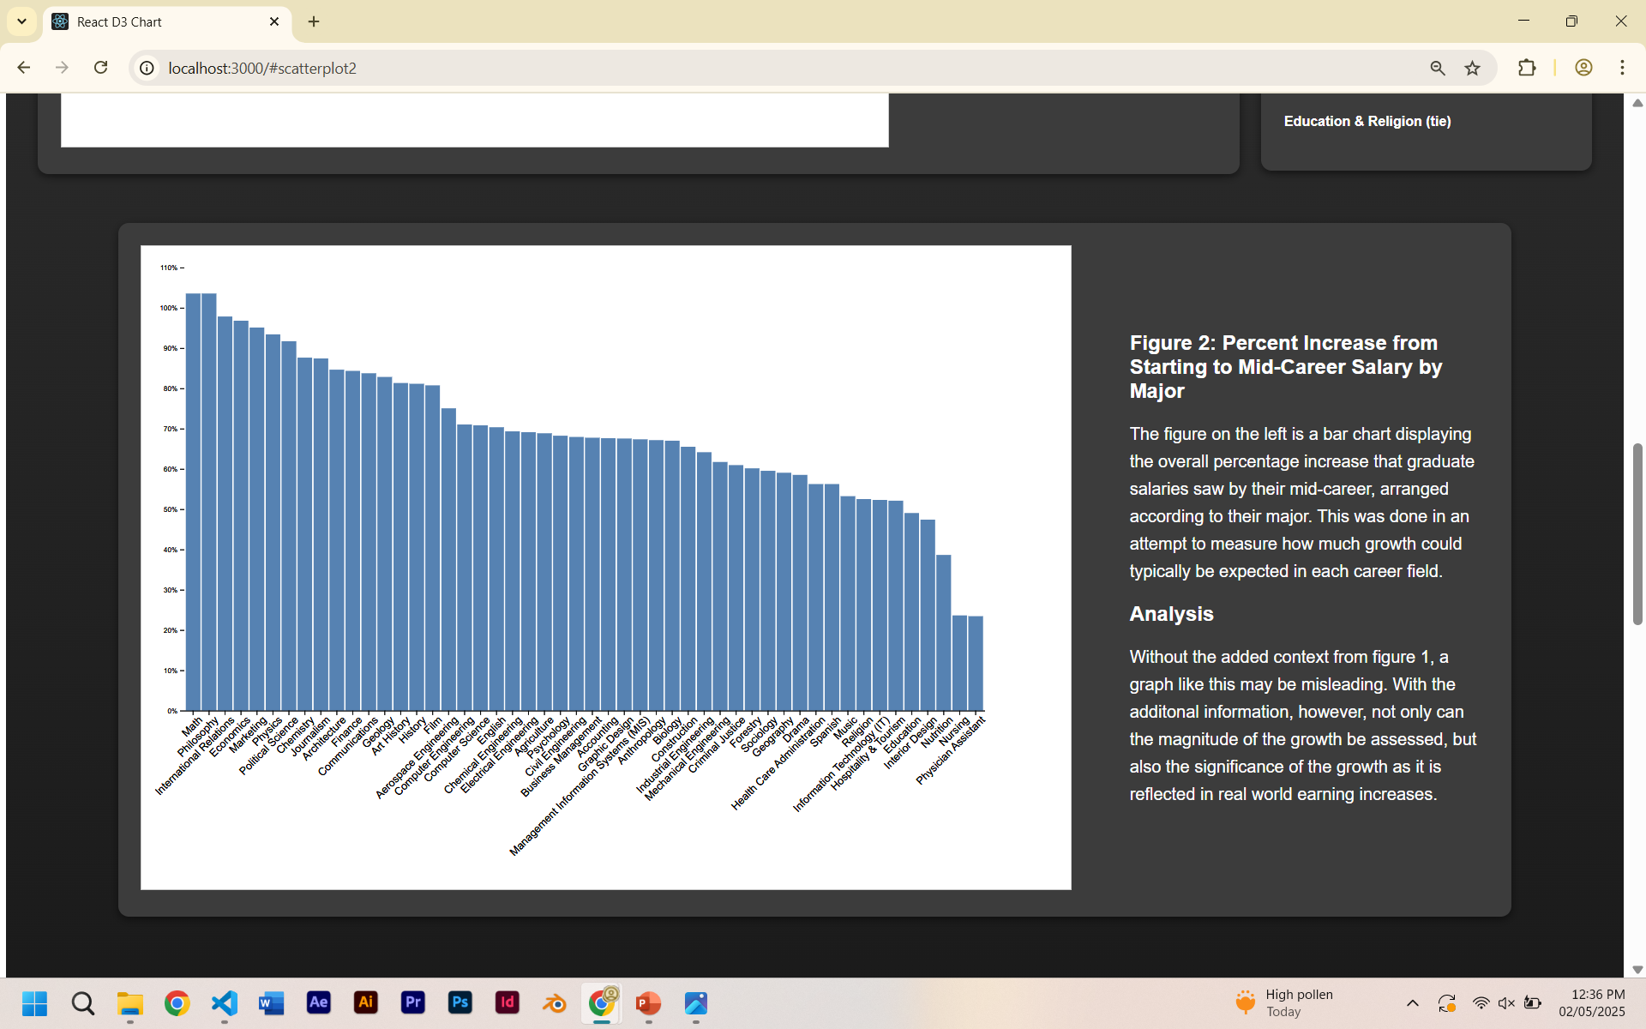
Figure 2
I created this using D3’s visualization library. This was created using Dataset 1.
The figure shows a bar chart which shows the percentage growth from starting salary to mid career by major.
This was done with the intention of visualizing how much career growth graduates could expect in their career.

Slide 10
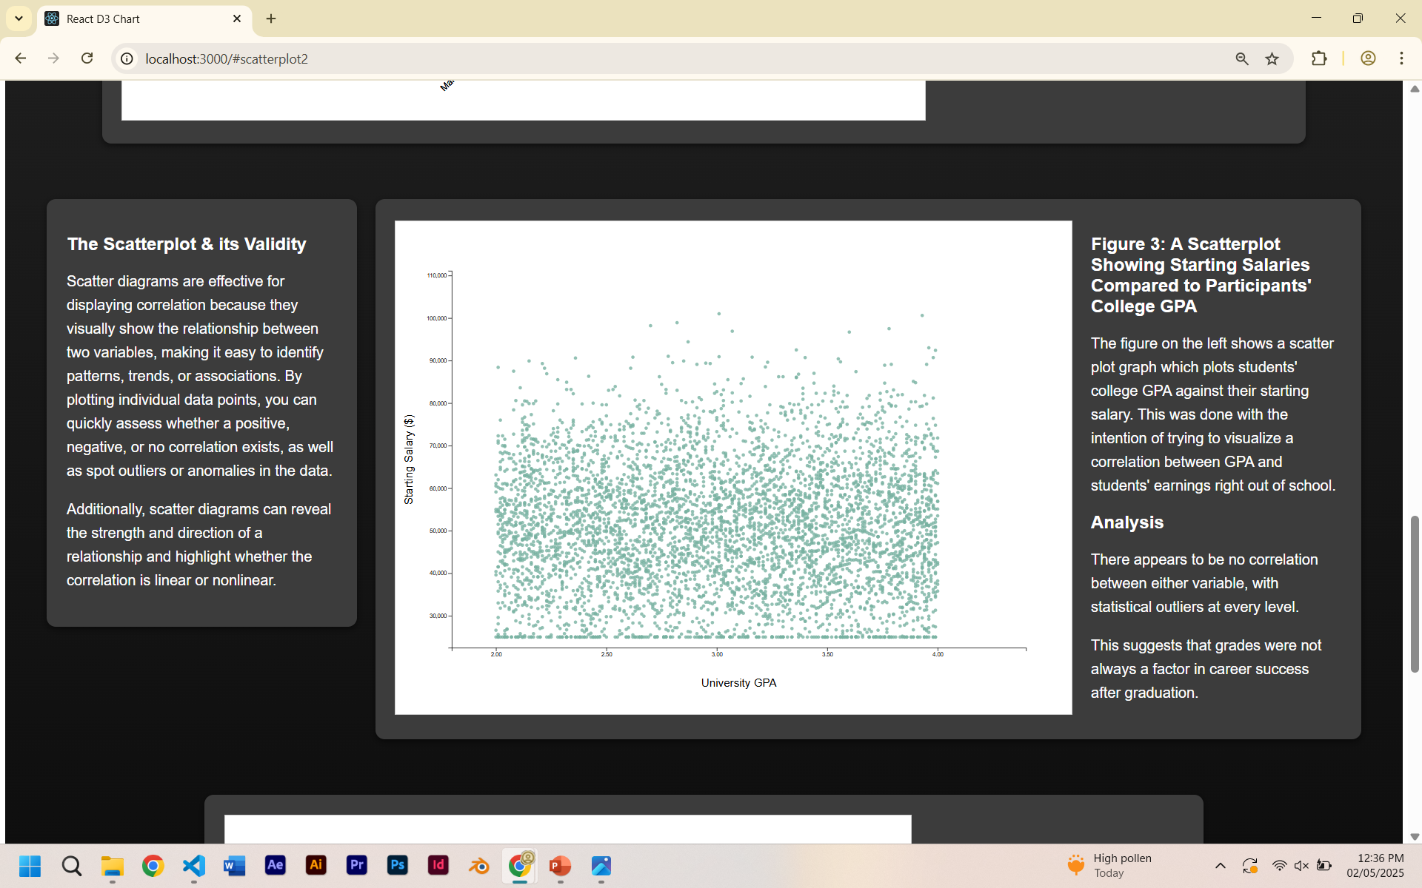
Figure 3
I created this using D3’s visualization library. This was created using Dataset 2.
The figure shows a scatterplot which maps graduates university GPA against their starting salary.
This was done with the intention of trying to establish a correlation between university GPA and earnings after graduation.

Slide 11
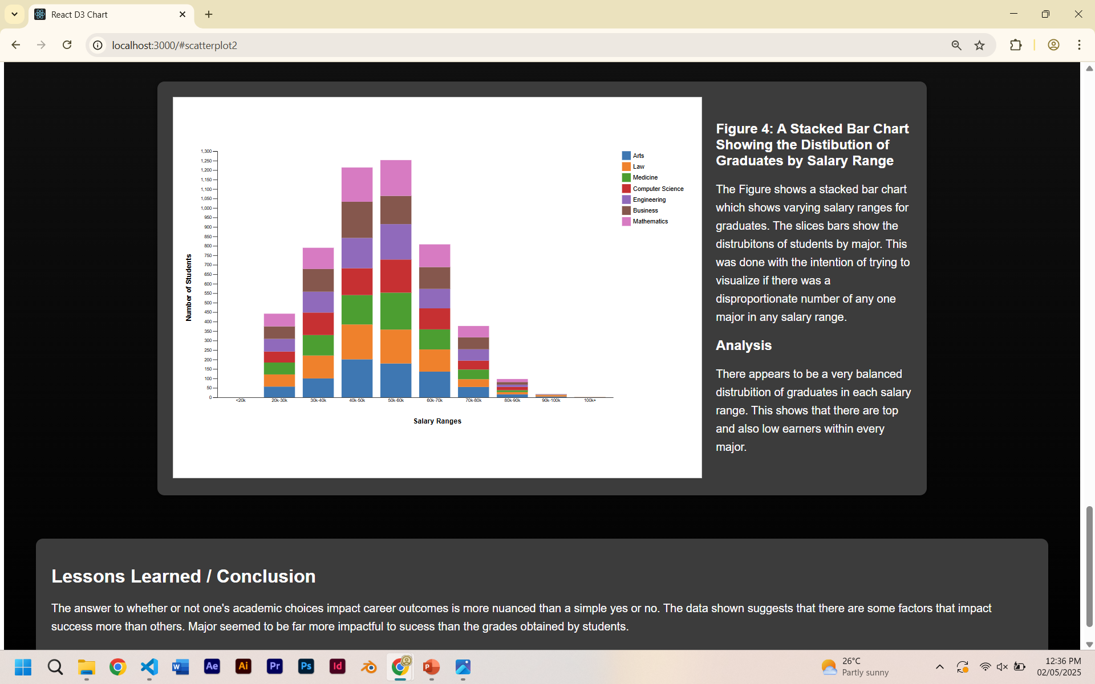
Figure 4 & Conclusion
I created this using D3’s visualization library. This was created using Dataset 1.
The figure shows a stacked bar chart which displays the distribution of graduates within each salary range, grouped by major.
This was done with the intention of finding out whether any salary range favored any one major.

Slide 12
Lessons Learned
Grades held less relevance over career outcomes than expected.
Student major proved to be extremely significant to career outcomes, especially in the long term.
The pay discrepancy between new graduates is not large, but widens considerably as graduates approach their mid-career.

